Slide 1
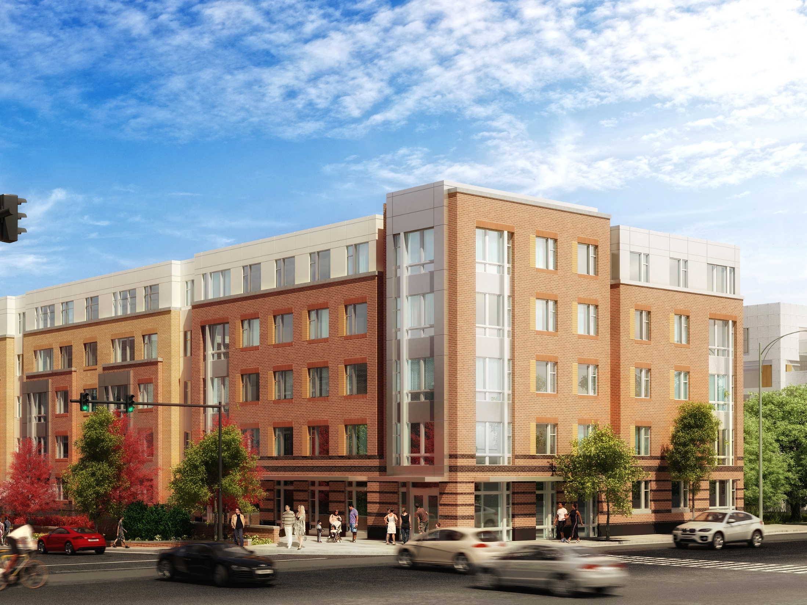
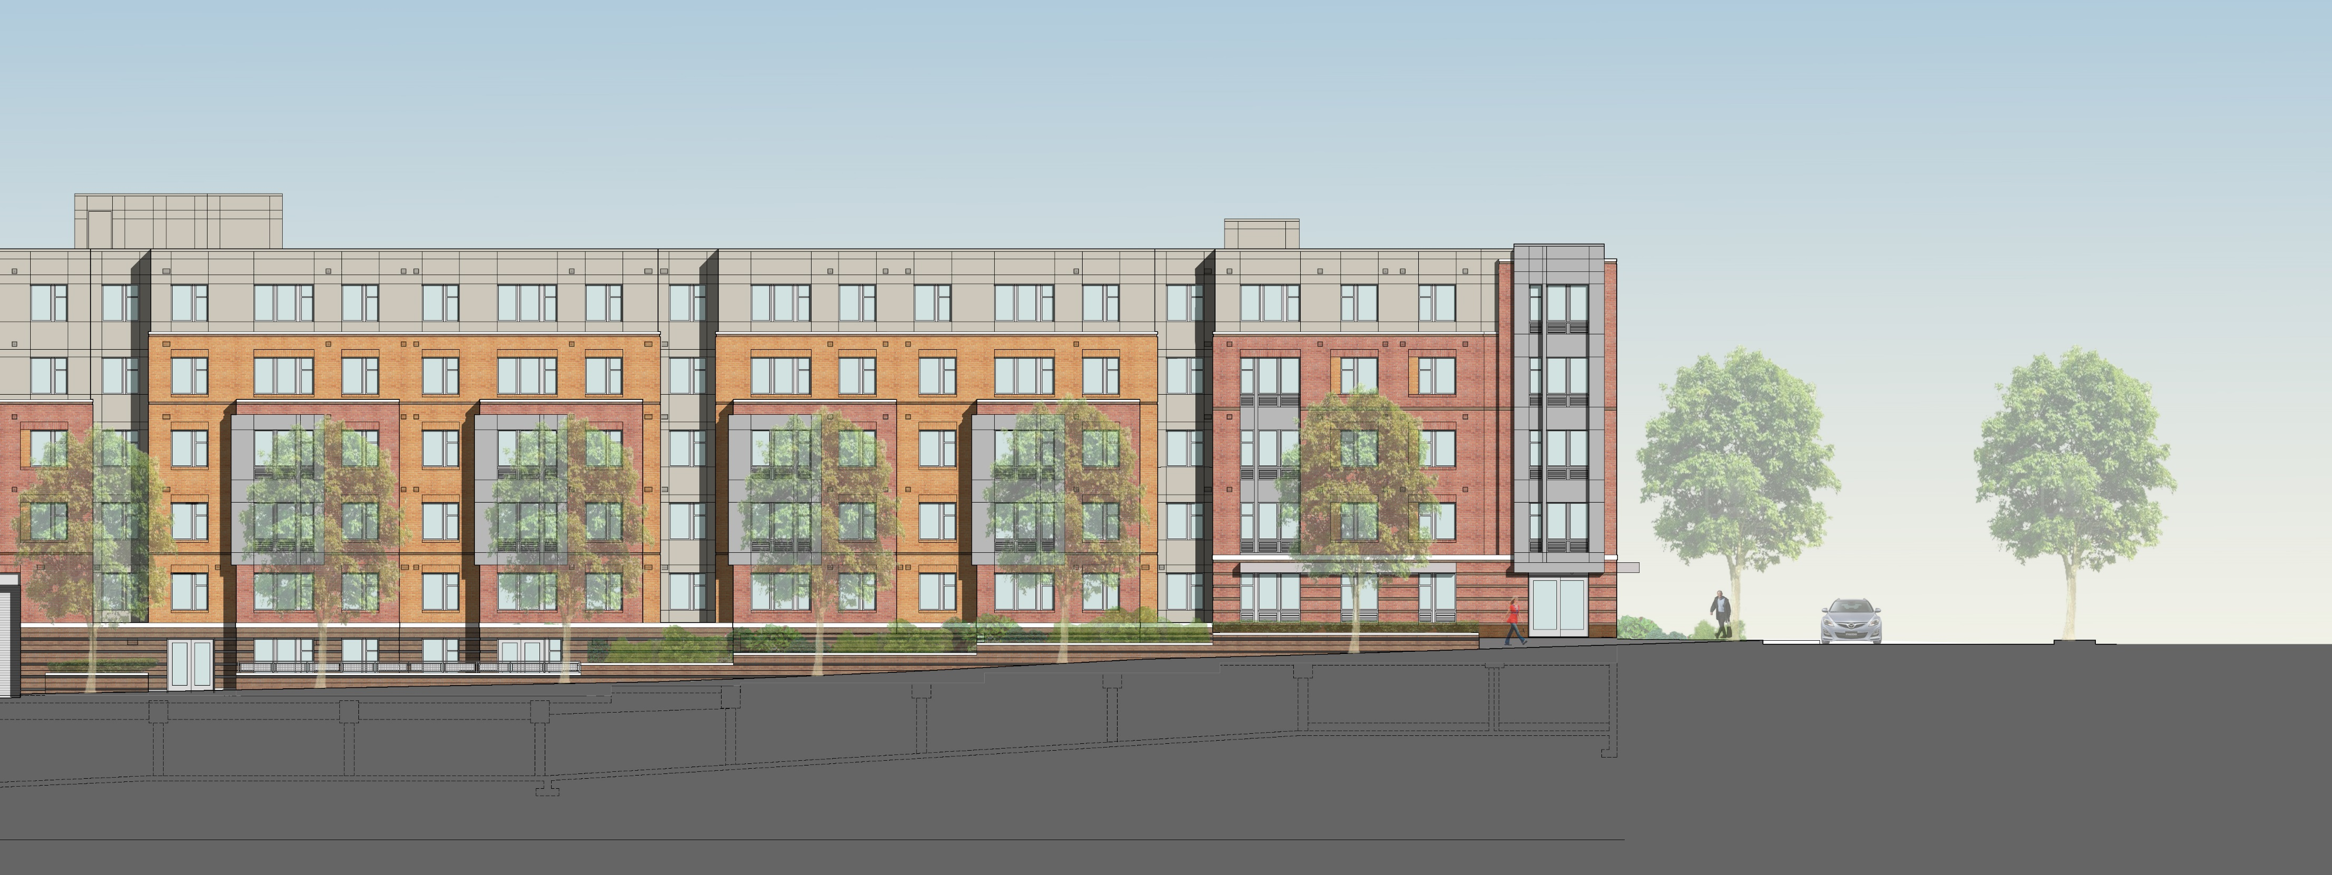
Jackson Crossing
Alexandria, Virginia
Michael Bologna
Structural Option
Advisor: Dr. Linda M. Hanagan
The Pennsylvania State University
Spring 2016

Slide 2
Introduction
General Building Information
Existing Gravity System
Existing Lateral System
Introduction ◆ Problem Statement/Goal ◆ Gravity System Redesign ◆ Lateral System Redesign ◆ Construction Management Breadth ◆ Conclusion/Acknowledgements

Slide 3
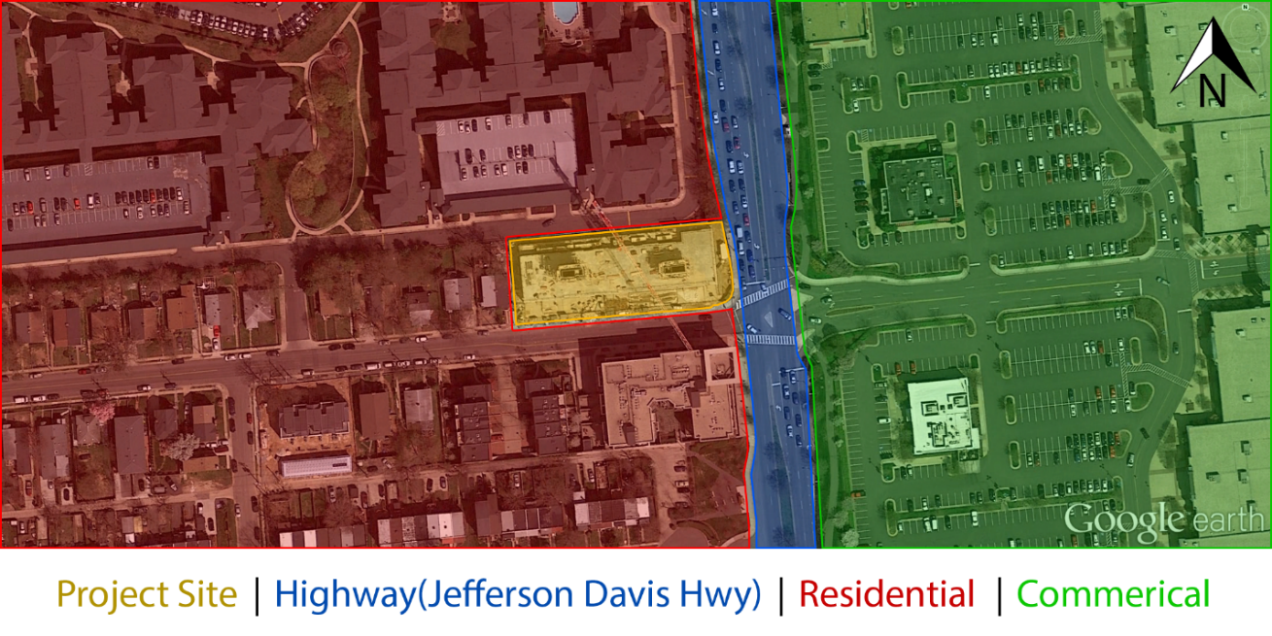

Introduction
General Building Information
Existing Gravity System
Existing Lateral System
Design Team
Owner: AHC, Inc.
CM: Harkins Builders, Inc.
Architect: Bonstra | Haresign Architects, LLP
Structural: Rathgeber and Goss Associates
Civil: VIKA, Virginia, LLC
MEP: Metropolitan Engineering, Inc.
Introduction ◆ Problem Statement/Goal ◆ Gravity System Redesign ◆ Lateral System Redesign ◆ Construction Management Breadth ◆ Conclusion/Acknowledgements

Slide 4
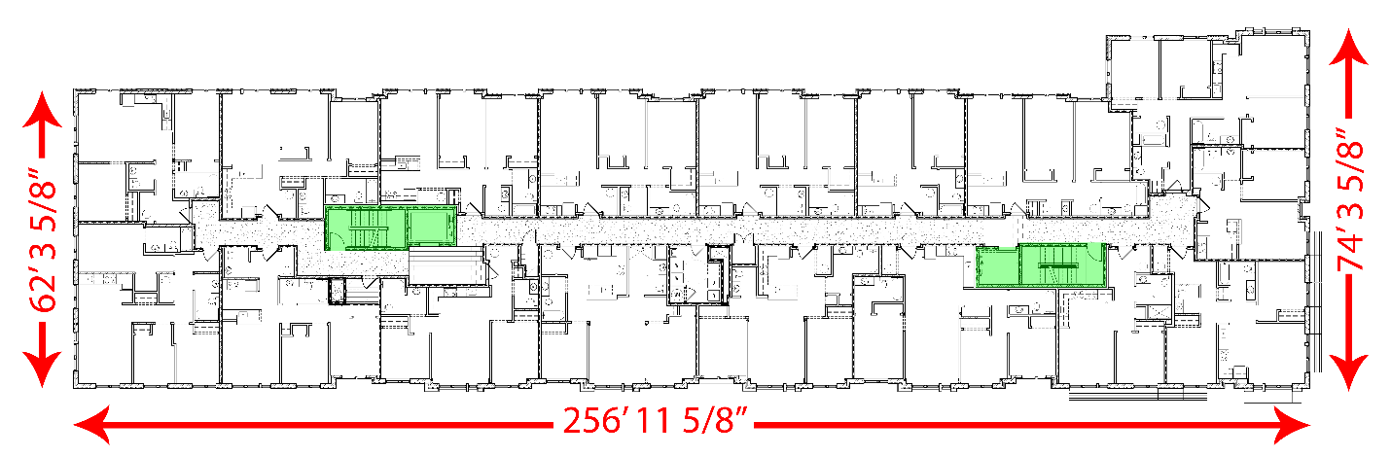

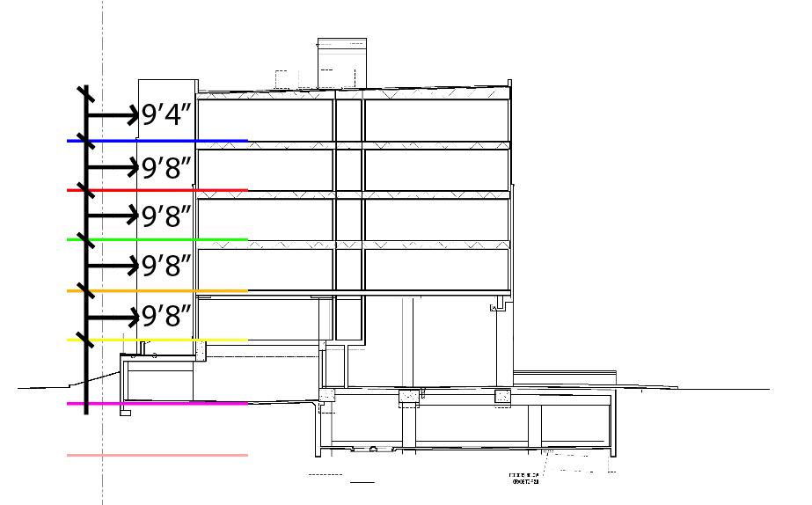
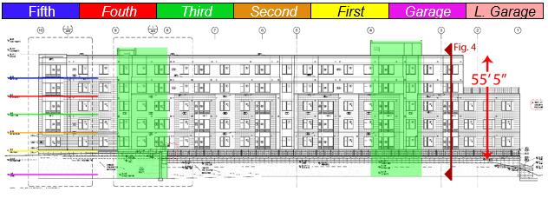
Introduction
General Building Information
Existing Gravity System
Existing Lateral System
▪ North Elevation
Introduction ◆ Problem Statement/Goal ◆ Gravity System Redesign ◆ Lateral System Redesign ◆ Construction Management Breadth ◆ Conclusion/Acknowledgements

Slide 5
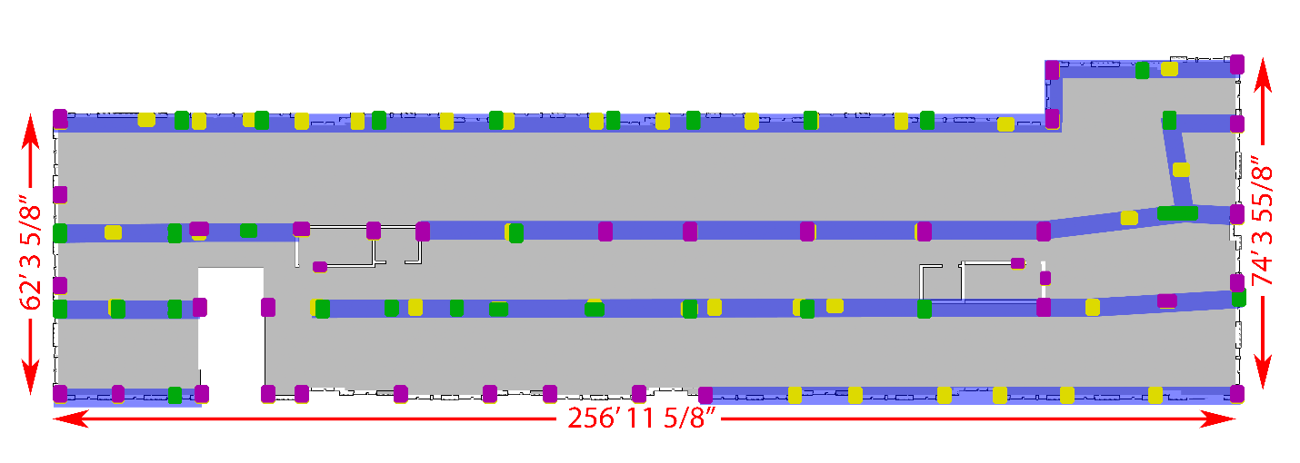
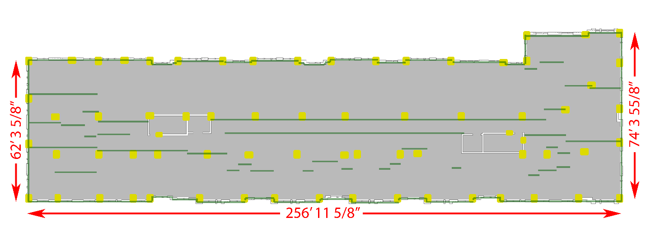
Introduction
Existing Gravity System
4 Floors of wood framing
  Rests on second floor podium slab
General Building Information
Existing Gravity System
Existing Lateral System
▪ First Floor Plan
Yellow – Supporting First Floor
Green – Supporting Second Floor
Purple – Supporting Both Floors
Blue – Concrete Beams
▪ Second Floor Plan
Introduction ◆ Problem Statement/Goal ◆ Gravity System Redesign ◆ Lateral System Redesign ◆ Construction Management Breadth ◆ Conclusion/Acknowledgements

Slide 6
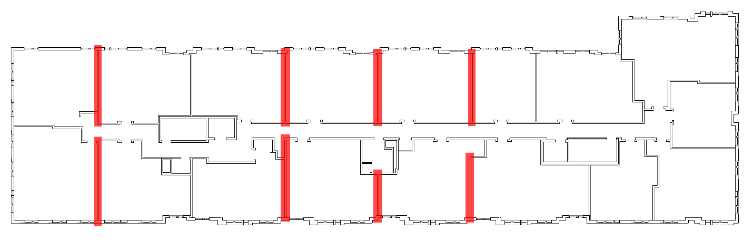
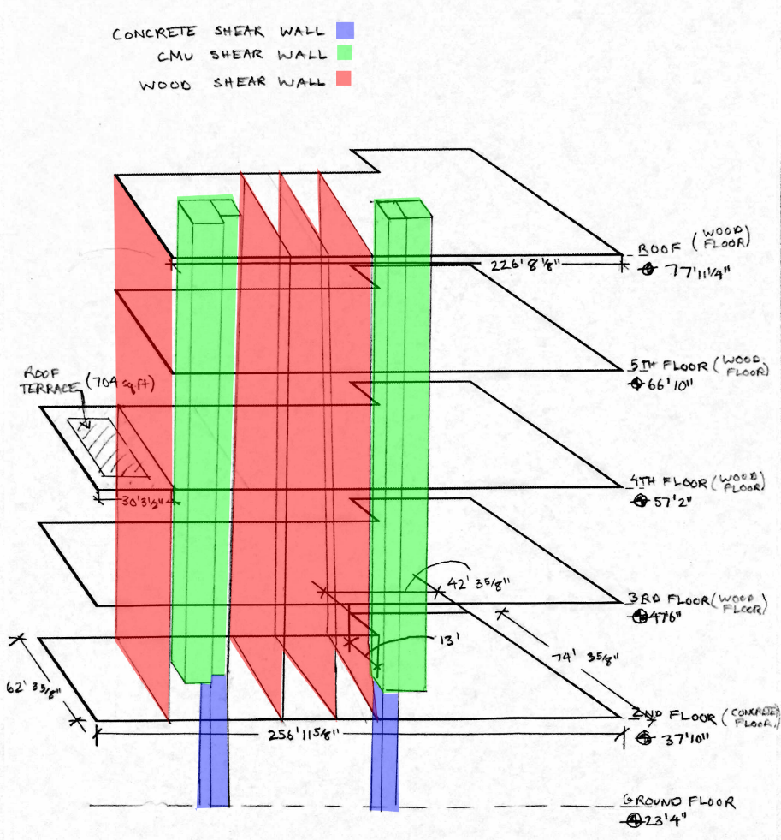
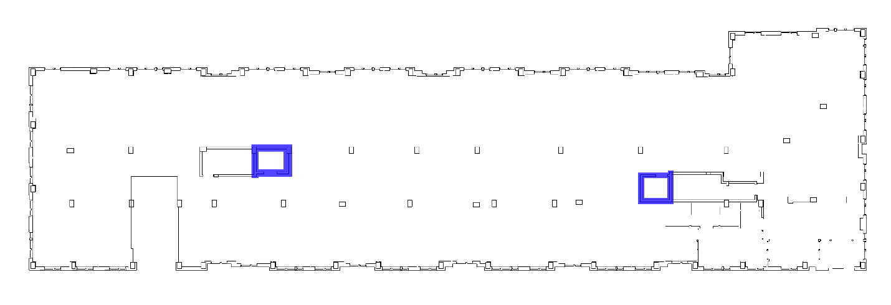
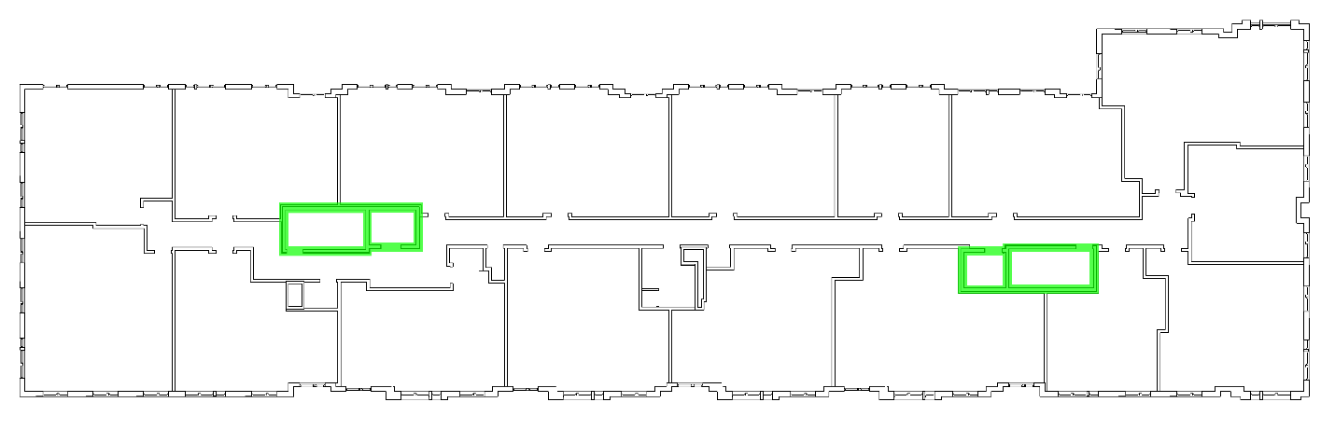
Introduction
General Building Information
Existing Gravity System
Existing Lateral System
▪ Wood Shear Walls on Typical Floor Plan
▪ Concrete Shear Walls at First Floor
▪ CMU Shear Walls on Typical Floor Plan
Introduction ◆ Problem Statement/Goal ◆ Gravity System Redesign ◆ Lateral System Redesign ◆ Construction Management Breadth ◆ Conclusion/Acknowledgements

Slide 7
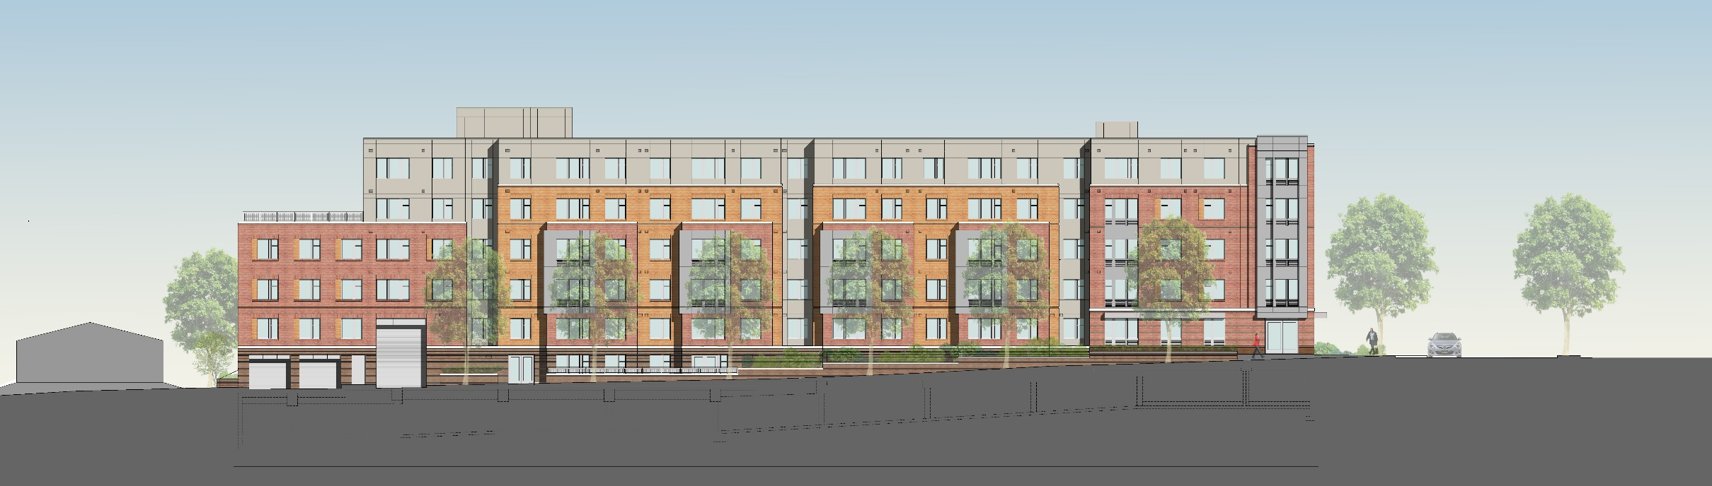
Problem Statement/Goal
Reduce amount of transfer members and the structural floor depth
Introduction ◆ Problem Statement/Goal ◆ Gravity System Redesign ◆ Lateral System Redesign ◆ Construction Management Breadth ◆ Conclusion/Acknowledgements

Slide 8
Gravity System Redesign
Gravity Columns
Two-Way Flat Plate Slab
Transfer Beams
Introduction ◆ Problem Statement/Goal ◆ Gravity System Redesign ◆ Lateral System Redesign ◆ Construction Management Breadth ◆ Conclusion/Acknowledgements

Slide 9
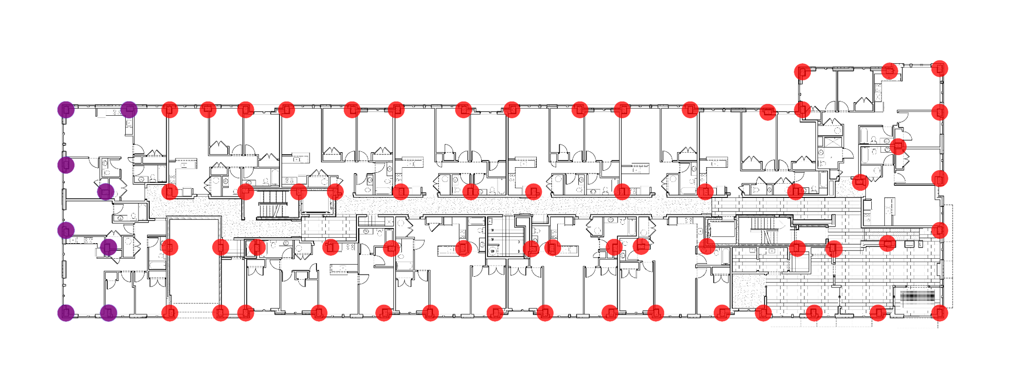
Gravity System Redesign
▪ Location of Columns on Typical Plan
▪ Columns not continuous to Roof in purple
Gravity Columns
Two-Way Flat Plate Slab
Transfer Beams
N
Introduction ◆ Problem Statement/Goal ◆ Gravity System Redesign ◆ Lateral System Redesign ◆ Construction Management Breadth ◆ Conclusion/Acknowledgements

Slide 10

Gravity System Redesign
▪ Location of Columns on Typical Plan
▪ Columns not continuous to Roof in purple
Initial Column Dimension
Chose to base off of compressive strength, φPn
$$φPn,max=0.80φ[0.85f^{′}c\left(Ag−Ast\right)+fyAst]$$
Pu for worst column equal to 525.1k
Need Ag=198.5in²
Initial Column Size:
14” by 14”
Gravity Columns
Two-Way Flat Plate Slab
Transfer Beams
N
Introduction ◆ Problem Statement/Goal ◆ Gravity System Redesign ◆ Lateral System Redesign ◆ Construction Management Breadth ◆ Conclusion/Acknowledgements

Slide 11
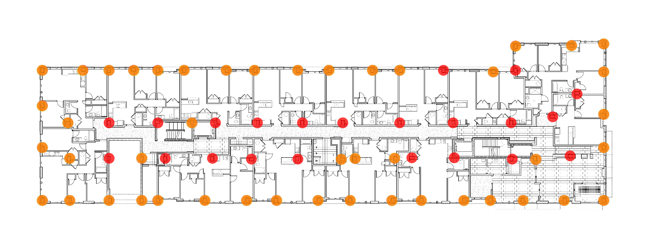
Gravity System Redesign
▪ Location of Columns on Typical Plan
Designed Columns
Column 1
Pu=525k
Mu1=30 k-ft
Mu2=10 k-ft
Column 2
Pu=260k
Mu1=2 k-ft
Mu2=11 k-ft
Gravity Columns
Two-Way Flat Plate Slab
Transfer Beams
Column 1
N
Column 2
Introduction ◆ Problem Statement/Goal ◆ Gravity System Redesign ◆ Lateral System Redesign ◆ Construction Management Breadth ◆ Conclusion/Acknowledgements

Slide 12
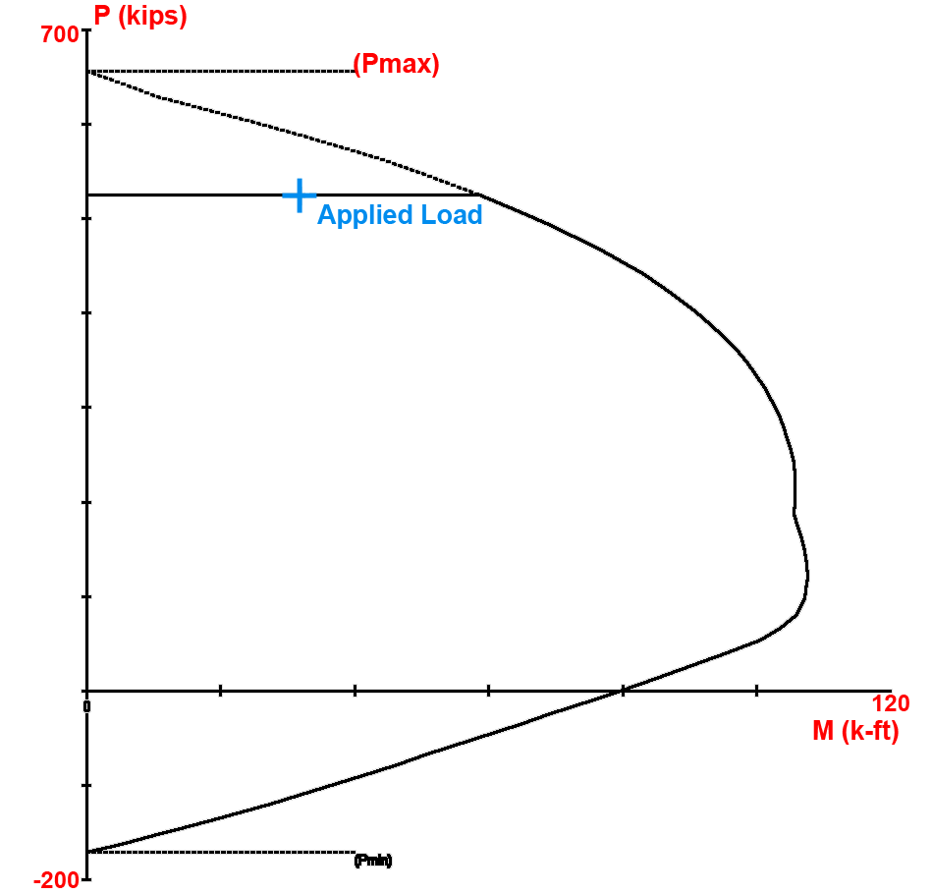
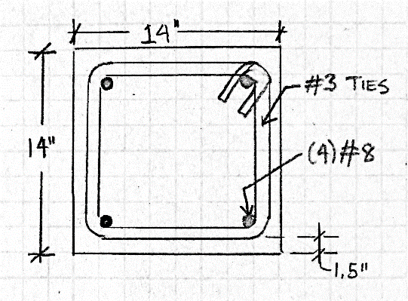
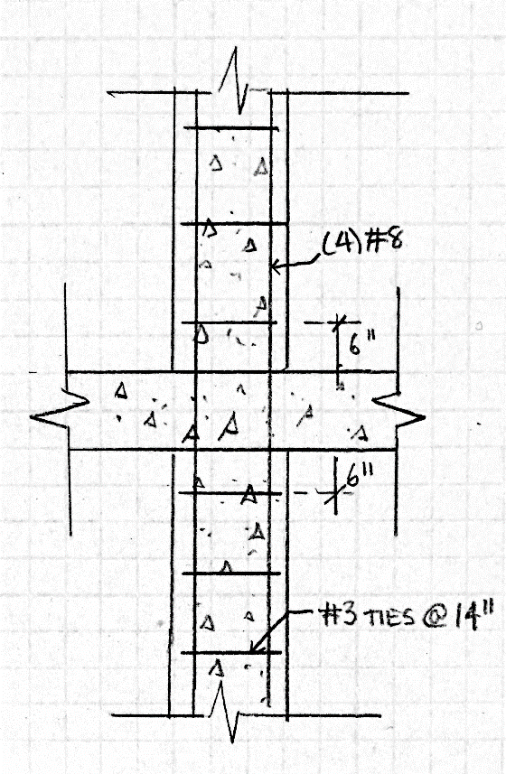
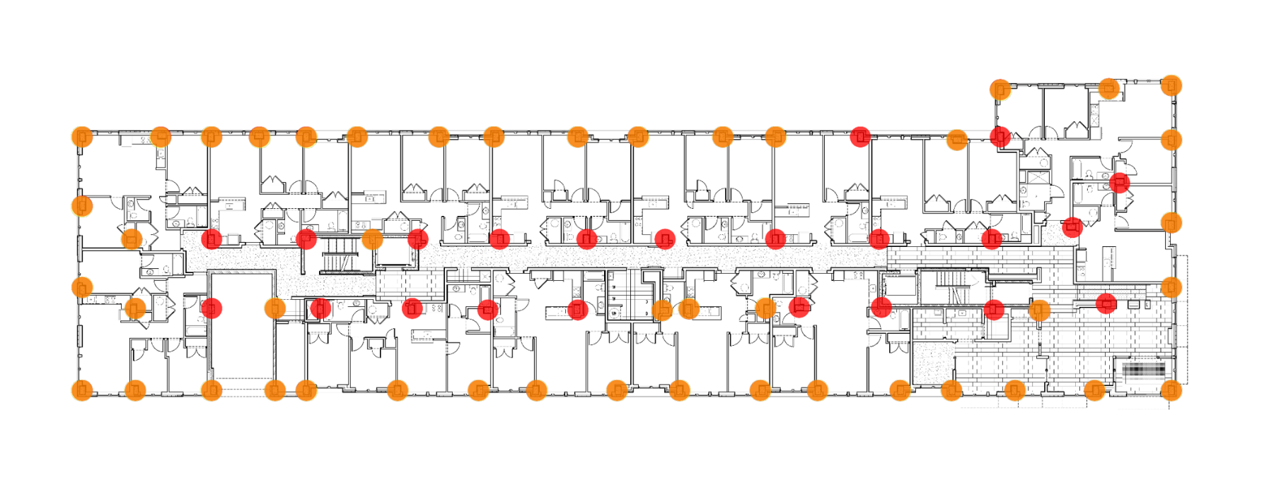

Gravity System Redesign
Column 1
14” by 14”
5,000 psi
Longitudinal Bars
  (4) #8
  1.61% Reinforcement
Stirrups
  #3 Ties
  14” o.c. (Maximum stirrup spacing)
Gravity Columns
Two-Way Flat Plate Slab
Transfer Beams
Column 1
Introduction ◆ Problem Statement/Goal ◆ Gravity System Redesign ◆ Lateral System Redesign ◆ Construction Management Breadth ◆ Conclusion/Acknowledgements

Slide 13
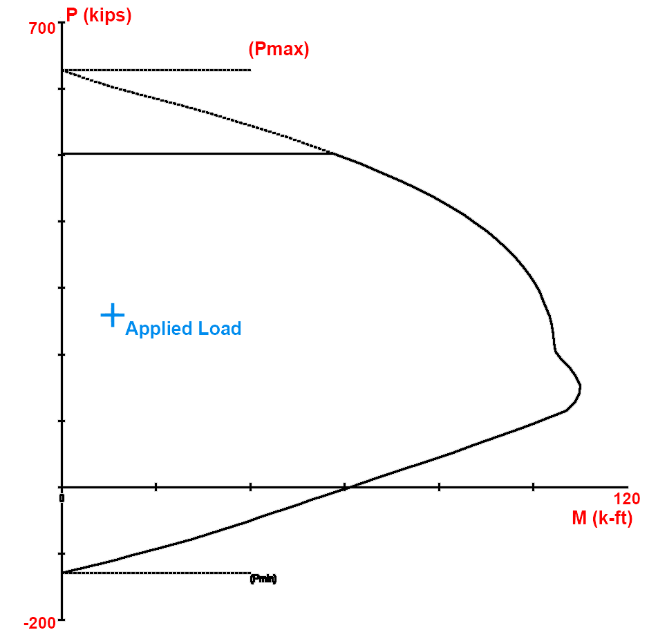
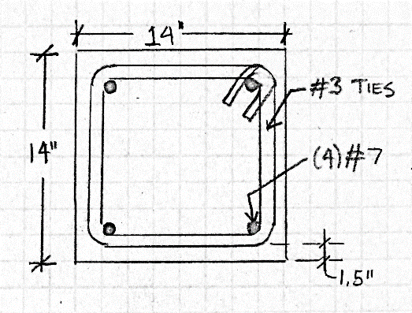
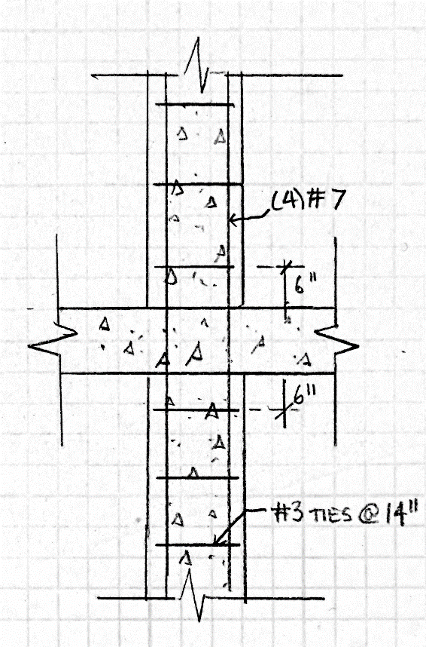
Gravity System Redesign
Column 2
14” by 14”
5,000 psi
Longitudinal Bars
  (4) #7
  1.22% Reinforcement
Stirrups
  #3 Ties
  14” o.c. (Maximum stirrup spacing)
Gravity Columns
Two-Way Flat Plate Slab
Transfer Beams
Column 2
Introduction ◆ Problem Statement/Goal ◆ Gravity System Redesign ◆ Lateral System Redesign ◆ Construction Management Breadth ◆ Conclusion/Acknowledgements

Slide 14
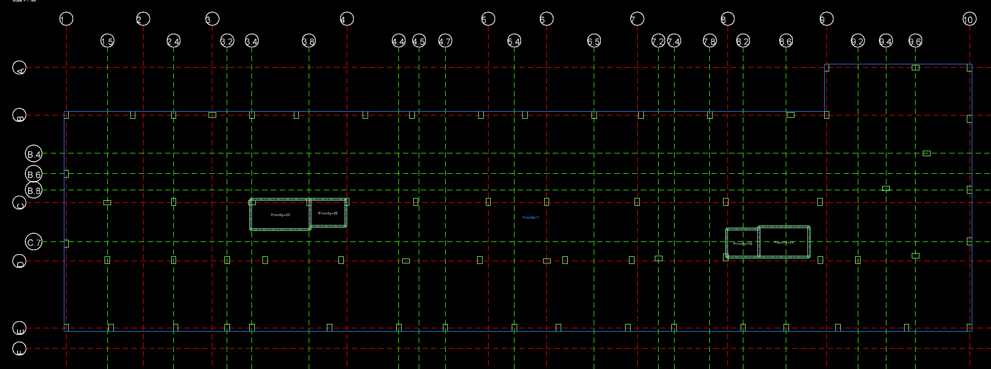
Gravity System Redesign
Initial Assumptions
9” Slab Thickness
  Based on 23’7” interior span
  Minimum thickness of ln/33
5,000 psi
No edge beams or drop panels
Gravity Columns
Two-Way Flat Plate Slab
Transfer Beams
N
Introduction ◆ Problem Statement/Goal ◆ Gravity System Redesign ◆ Lateral System Redesign ◆ Construction Management Breadth ◆ Conclusion/Acknowledgements

Slide 15
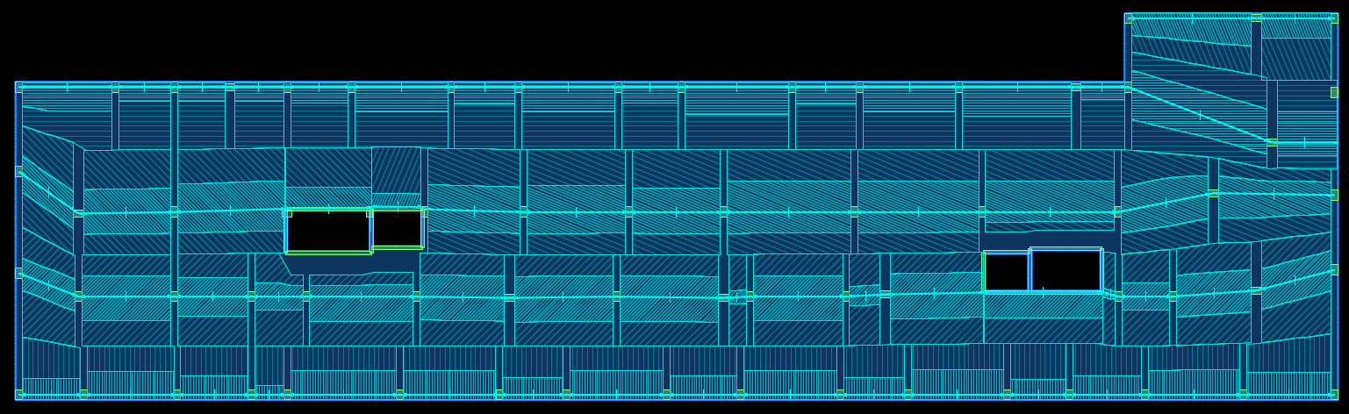
Gravity System Redesign
Slab Reinforcement
Top Cover: 1.5”
Bottom Cover: 1.5”
Design System: Two-Way Slab
▪ Latitude Design Strips for Floors 2 and 3
Gravity Columns
Two-Way Flat Plate Slab
Transfer Beams
N
Introduction ◆ Problem Statement/Goal ◆ Gravity System Redesign ◆ Lateral System Redesign ◆ Construction Management Breadth ◆ Conclusion/Acknowledgements

Slide 16
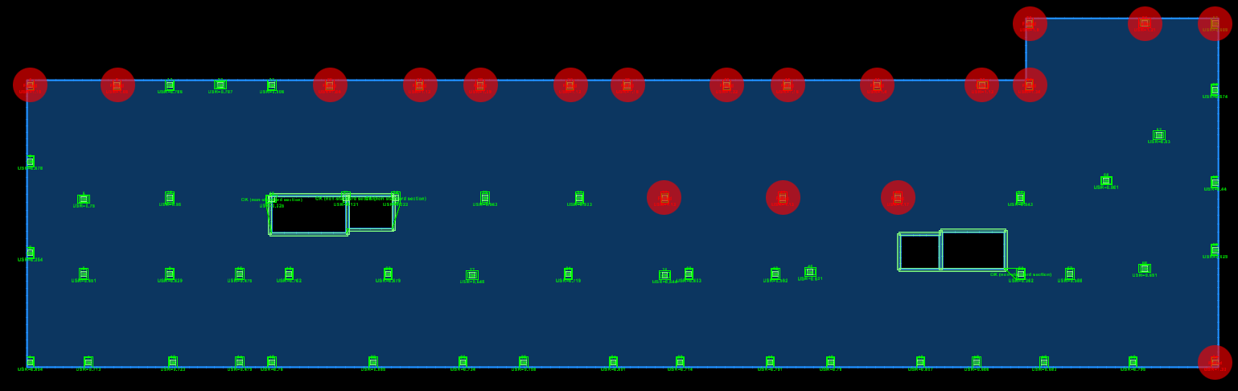
Gravity System Redesign
▪ Locations of Punching Shear Failure
Gravity Columns
Two-Way Flat Plate Slab
Transfer Beams
N
Introduction ◆ Problem Statement/Goal ◆ Gravity System Redesign ◆ Lateral System Redesign ◆ Construction Management Breadth ◆ Conclusion/Acknowledgements

Slide 17
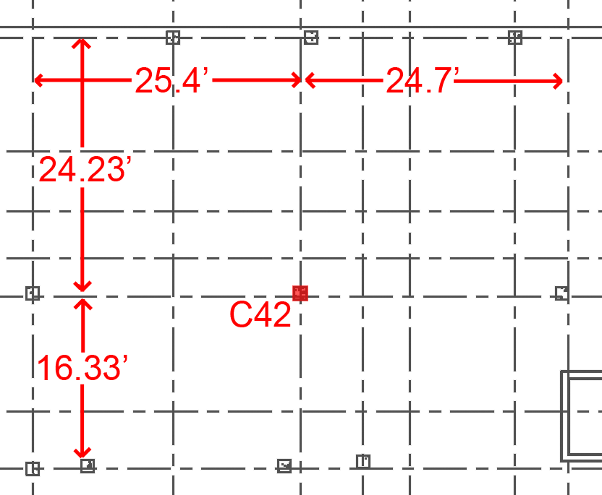
Gravity System Redesign
▪ Locations of Punching Shear Failure
Gravity Columns
Two-Way Flat Plate Slab
Transfer Beams
N
Introduction ◆ Problem Statement/Goal ◆ Gravity System Redesign ◆ Lateral System Redesign ◆ Construction Management Breadth ◆ Conclusion/Acknowledgements

Slide 18
Gravity System Redesign
Punching Shear
Shear stress with unbalanced moment
  358.82psi
b_{o} required due to this stress:
  b_{o}=135”
Solution:
  28” by 28” by 12” deep shear caps
  Edge beams
Gravity Columns
Two-Way Flat Plate Slab
Transfer Beams
67 k-ft
Introduction ◆ Problem Statement/Goal ◆ Gravity System Redesign ◆ Lateral System Redesign ◆ Construction Management Breadth ◆ Conclusion/Acknowledgements

Slide 19
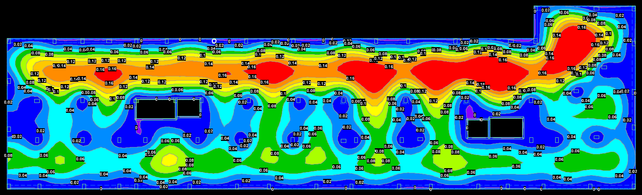

Gravity System Redesign
Final Slab
8” Thickness
  Meets deflection requirements
Bottom mat of #5 at 12” o.c. each way
Edge beams and shear caps where necessary
▪ Long Term Deflection on Second Floor
Gravity Columns
Two-Way Flat Plate Slab
Transfer Beams
N
Introduction ◆ Problem Statement/Goal ◆ Gravity System Redesign ◆ Lateral System Redesign ◆ Construction Management Breadth ◆ Conclusion/Acknowledgements

Slide 20
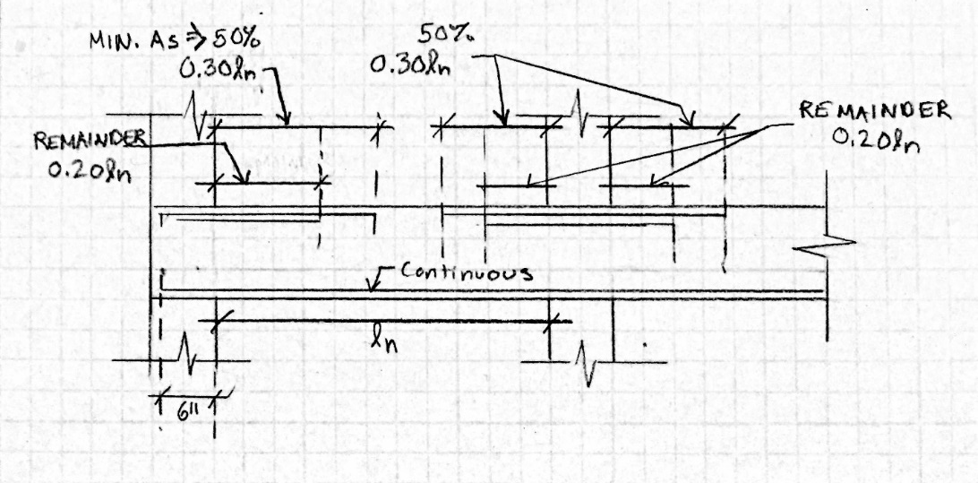
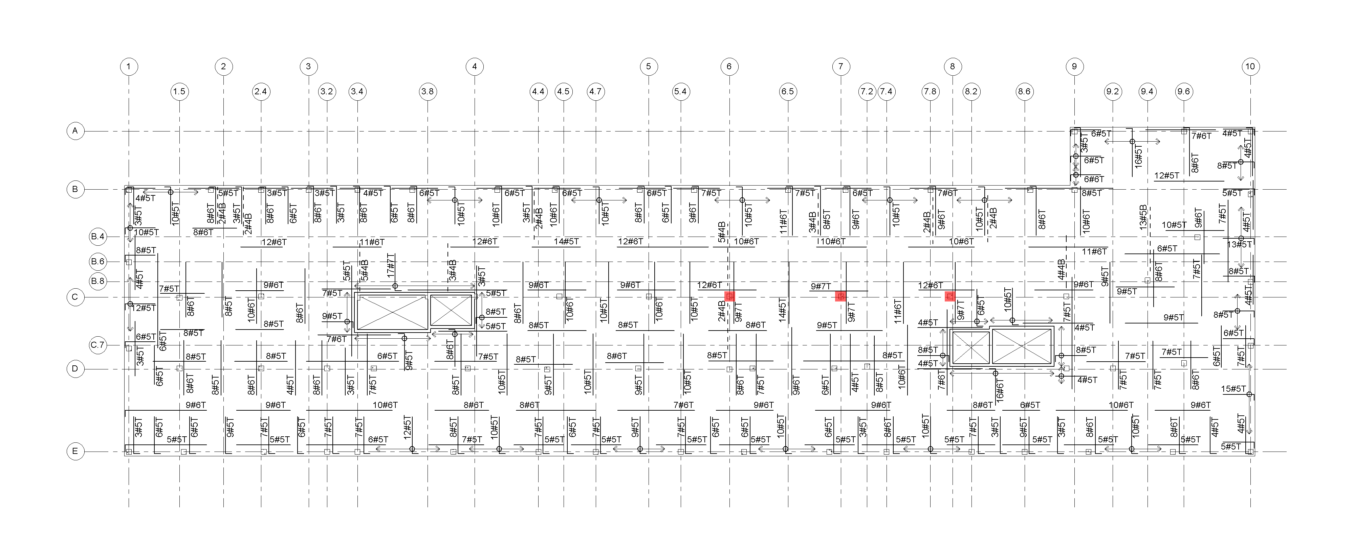
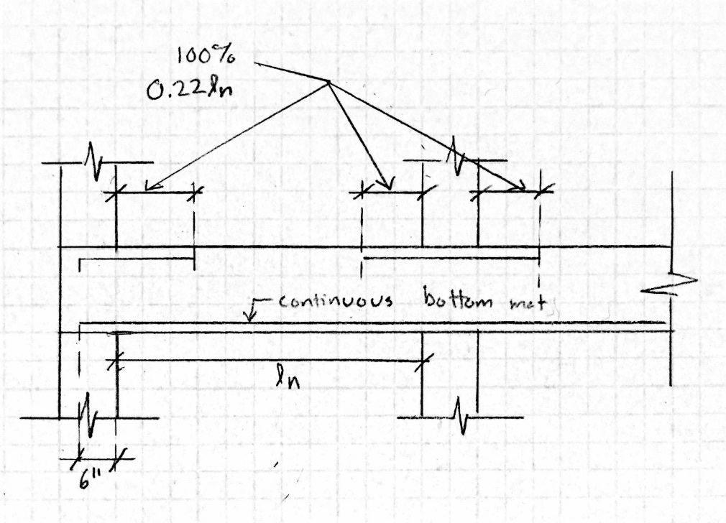
Gravity System Redesign
Column Strip
Middle Strip
▪ Reinforcement Plan of Second Floor
Gravity Columns
Two-Way Flat Plate Slab
Transfer Beams
N
Introduction ◆ Problem Statement/Goal ◆ Gravity System Redesign ◆ Lateral System Redesign ◆ Construction Management Breadth ◆ Conclusion/Acknowledgements

Slide 21
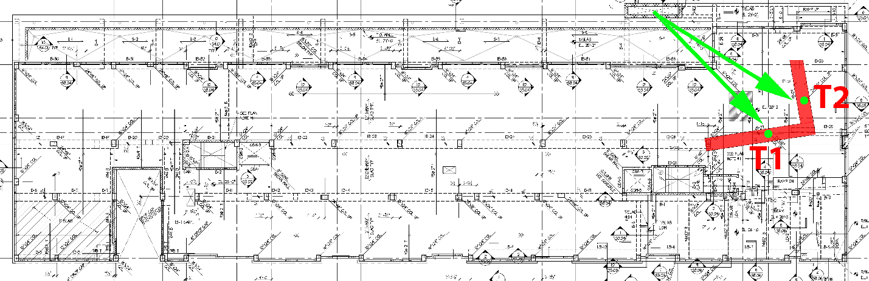
Gravity System Redesign
Transfer Beams
Existing Transfer Beam T1
  Width x Depth: 48” x 36”
  Bottom Bars: 14#10
  Top Bars: 8#9 at Full Length
  Stirrups: 4 Leg #4, 1 at 2” and rest at 8” on center
Existing Transfer Beam T2
  Width x Depth: 48” x 36”
  Bottom Bars: 12#9
  Top Bars: 6#9 at Full Length
  Stirrups: 4 Leg #4, 1 at 2” and rest at 12” on center
Gravity Columns
Two-Way Flat Plate Slab
Transfer Beams
New Transfer Beam T1
  Width x Depth: 48” x 36”
  Bottom Bars: 14#10
  Top Bars: 12#10 at Full Length
  Stirrups: 4 Leg #4, 1 at 2” and rest at 6” on center
New Transfer Beam T2
  Width x Depth: 48” x 36”
  Bottom Bars: 12#9
  Top Bars: 8#9 at Full Length
  Stirrups: 4 Leg #4, 1 at 2” and rest at 12” on center
Introduction ◆ Problem Statement/Goal ◆ Gravity System Redesign ◆ Lateral System Redesign ◆ Construction Management Breadth ◆ Conclusion/Acknowledgements

Slide 22
Lateral System Redesign
Lateral Loads
Moment Frame Columns
Moment Frame Beams
Introduction ◆ Problem Statement/Goal ◆ Gravity System Redesign ◆ Lateral System Redesign ◆ Construction Management Breadth ◆ Conclusion/Acknowledgements

Slide 23
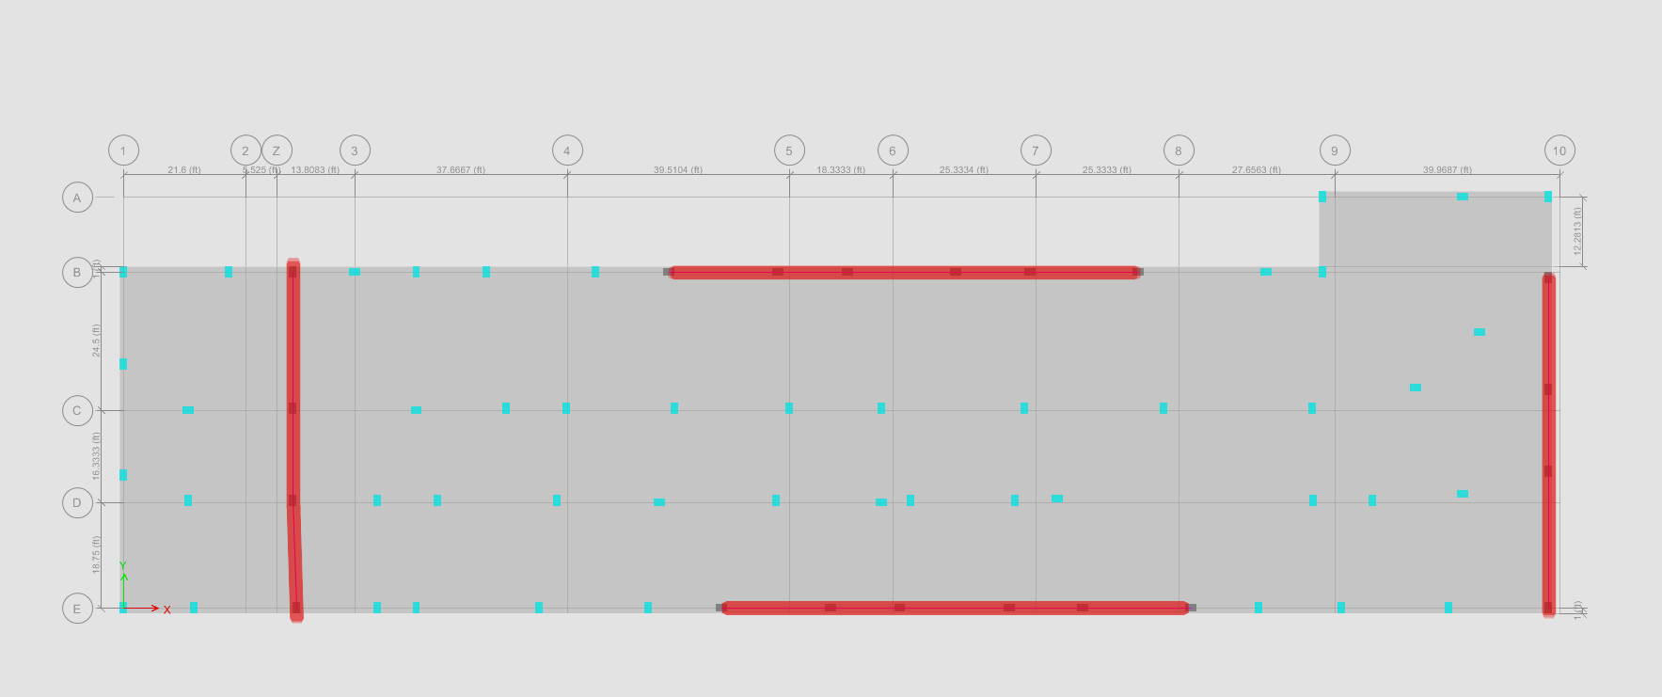
Lateral System Redesign
▪ Location of Moment Frames on Typical Plan
Moment Frames are located on exterior of structure to reduce twist
Difference between C.O.R. and C.O.M.
  For first 3 stories
    ~3 ft in X direction
    ~1 ft in Y direction
  For Fifth and Roof
    ~3 ft in X direction
    ~1.5 ft in Y direction
Lateral Loads
Moment Frame Columns
Moment Frame Beams
COM
COR
N
Introduction ◆ Problem Statement/Goal ◆ Gravity System Redesign ◆ Lateral System Redesign ◆ Construction Management Breadth ◆ Conclusion/Acknowledgements

Slide 24
Lateral System Redesign
▪ Location of Moment Frames on Typical Plan
Lateral Loads
Seismic was controlling case in both directions
Lateral Loads
Moment Frame Columns
Moment Frame Beams
N
Introduction ◆ Problem Statement/Goal ◆ Gravity System Redesign ◆ Lateral System Redesign ◆ Construction Management Breadth ◆ Conclusion/Acknowledgements

Slide 25
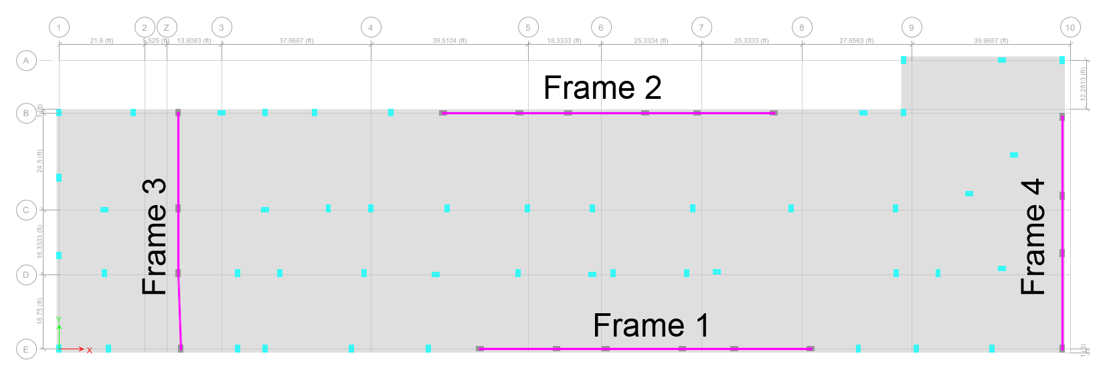
Lateral System Redesign
▪ Location of Moment Frames on Typical Plan
Frames 1 and 2
Final Reinforcing
  2 Layers of 3#8
  #4 Stirrups spaced at 16” on center
Lateral Loads
Moment Frame Columns
Moment Frame Beams
N
Introduction ◆ Problem Statement/Goal ◆ Gravity System Redesign ◆ Lateral System Redesign ◆ Construction Management Breadth ◆ Conclusion/Acknowledgements

Slide 26
Lateral System Redesign
▪ Location of Moment Frames on Typical Plan
Frames 3 and 4
Final Reinforcing
  2 Layers of 4#8
  #4 Stirrups spaced at 16” on center
Lateral Loads
Moment Frame Columns
Moment Frame Beams
N
Introduction ◆ Problem Statement/Goal ◆ Gravity System Redesign ◆ Lateral System Redesign ◆ Construction Management Breadth ◆ Conclusion/Acknowledgements

Slide 27
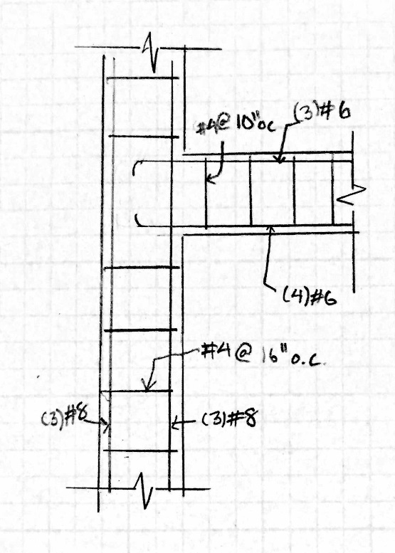
Lateral System Redesign
▪ Location of Moment Frames on Typical Plan
Frames 1 and 2
Final Reinforcing
  Bottom Bars: (4) #6 Full Length
  Top Bars: (3) #6 Full Length
  Stirrups: 2 leg #4 at 10” o.c.
Lateral Loads
Moment Frame Columns
Moment Frame Beams
N
Introduction ◆ Problem Statement/Goal ◆ Gravity System Redesign ◆ Lateral System Redesign ◆ Construction Management Breadth ◆ Conclusion/Acknowledgements

Slide 28
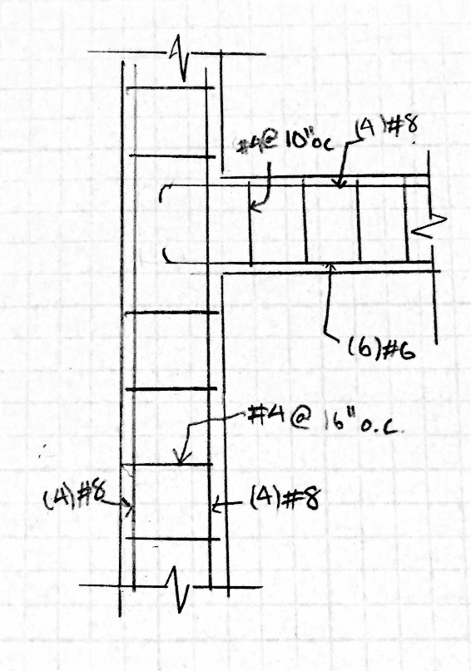
Lateral System Redesign
▪ Location of Moment Frames on Typical Plan
Frames 3 and 4
Final Reinforcing
  Bottom Bars: (6) #6 Full Length
  Top Bars: (4) #8 Full Length
  Stirrups: 2 leg #4 at 10” o.c.
Lateral Loads
Moment Frame Columns
Moment Frame Beams
N
Introduction ◆ Problem Statement/Goal ◆ Gravity System Redesign ◆ Lateral System Redesign ◆ Construction Management Breadth ◆ Conclusion/Acknowledgements

Slide 29
Lateral System Redesign
▪ Location of Moment Frames on Typical Plan
Lateral Loads
Moment Frame Columns
Moment Frame Beams
N
Introduction ◆ Problem Statement/Goal ◆ Gravity System Redesign ◆ Lateral System Redesign ◆ Construction Management Breadth ◆ Conclusion/Acknowledgements

Slide 30
Construction Management Breadth
Breadth Topics:
      Impact on:
        Structural cost
        Critical Path
    Other Breadth Topics:
      Acoustical Consideration
        Impact on:
          STC Rating
          IIC Rating
Cost Analysis
Schedule Analysis
Introduction ◆ Problem Statement/Goal ◆ Gravity System Redesign ◆ Lateral System Redesign ◆ Construction Management Breadth ◆ Conclusion/Acknowledgements

Slide 31
Construction Management Breadth
Cost Analysis
The cost estimate for the redesign structure will take into account the following:
• Material costs of concrete mix for the slab, beams, columns, and shear caps
• Labor and equipment costs for placing the concrete mix with pumping
• Material and labor costs for formwork
• Material and labor costs for reinforcement of slabs and columns.
Individual Costs:
Concrete Mix: $272,200
Placing Concrete: $60,600
Formwork: $648,200
Rebar: $36,900
Total Cost: $1,063,500 or $212,700 per floor
Existing Structure Cost: $175,000 per floor
22% Increase in Cost
Cost Analysis
Schedule Analysis
Introduction ◆ Problem Statement/Goal ◆ Gravity System Redesign ◆ Lateral System Redesign ◆ Construction Management Breadth ◆ Conclusion/Acknowledgements

Slide 32
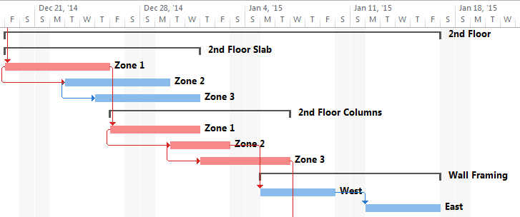
Construction Management Breadth
Schedule Analysis
Existing schedule had a duration of 45 days for wood framing
Total duration of concrete structure was 69 days
  Increase of 24 days along the critical path
Cost Analysis
Schedule Analysis
Placing of concrete and columns split into 3 zones
The duration for slabs and columns:
  Formwork: 2 days
  Reinforcement: 2 days
  Pour: 1 days
Introduction ◆ Problem Statement/Goal ◆ Gravity System Redesign ◆ Lateral System Redesign ◆ Construction Management Breadth ◆ Conclusion/Acknowledgements

Slide 33
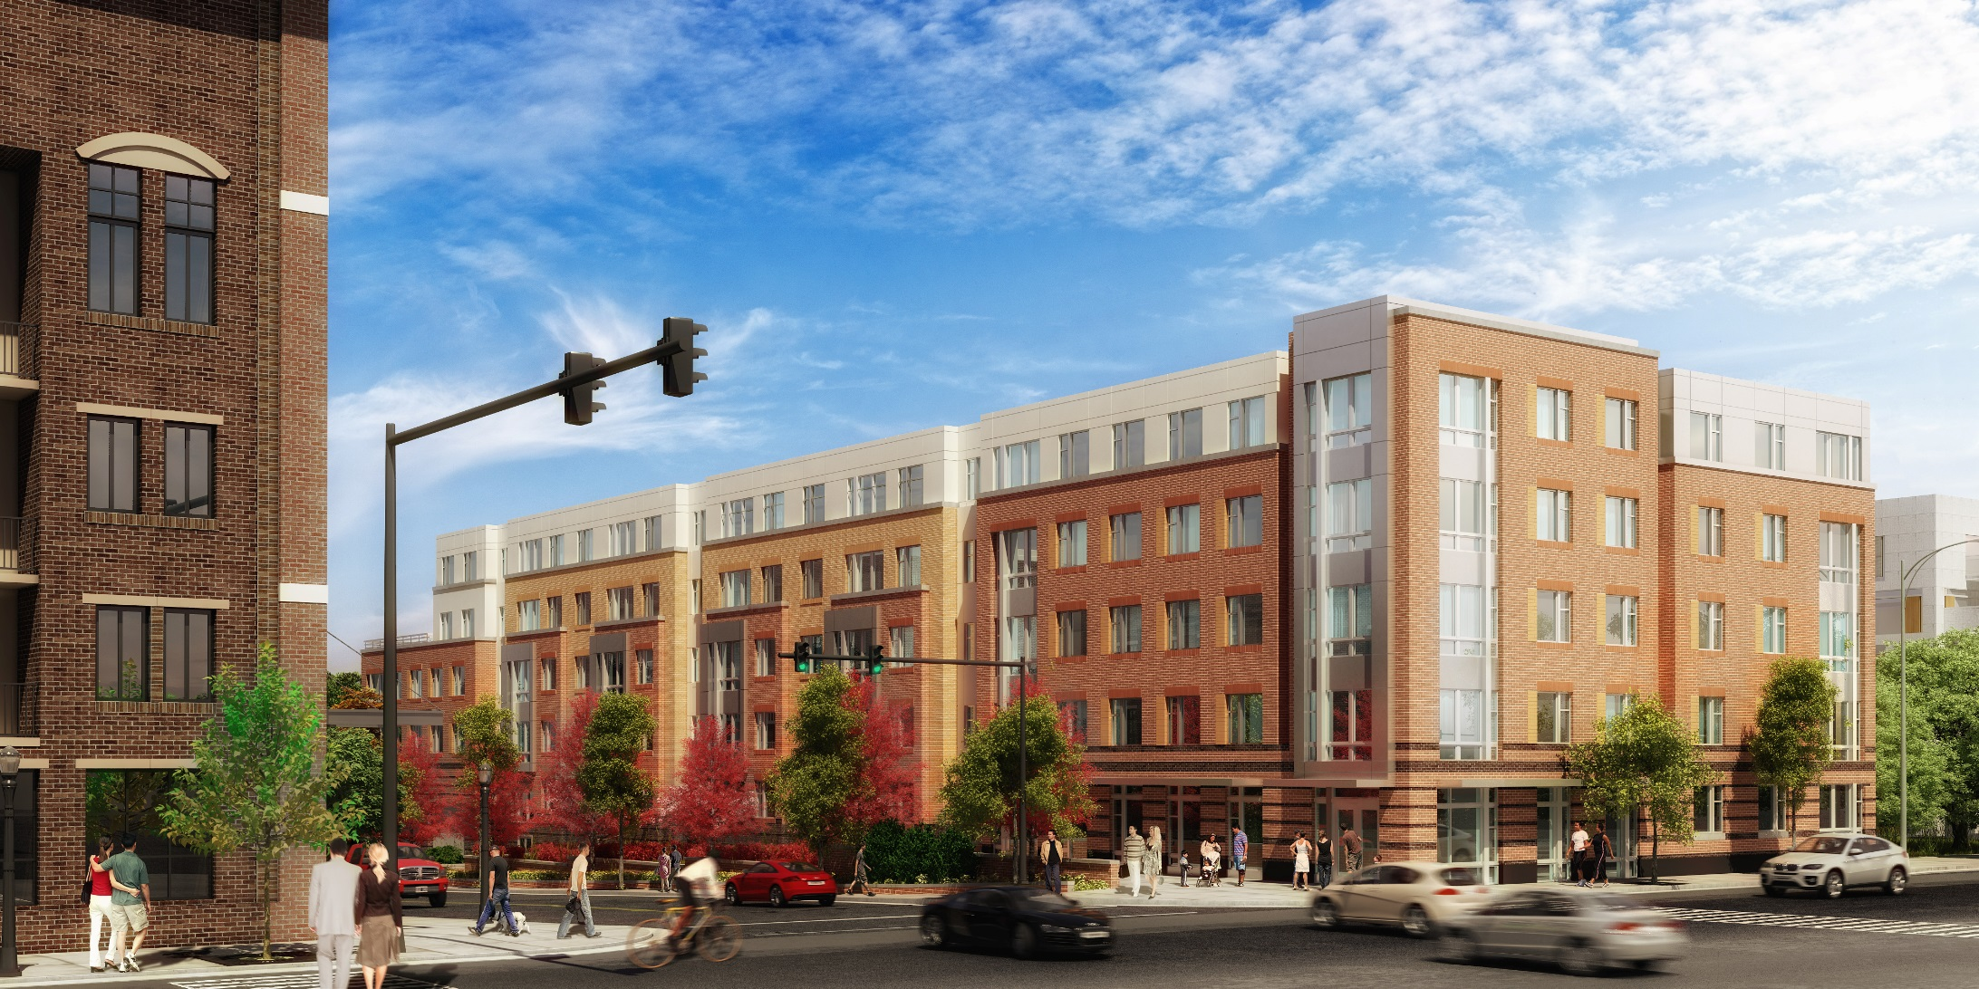
Thank you to the following people:
• Rathgeber and Goss Associates, especially Justin Domire
• AHC, Inc.
• Harkins Builders, especially Russell Tipton
• My classmates at Penn State along with my friends and family at home.
• Professors in the AE Department, especially my advisor Dr. Linda Hanagan.
Questions?
Introduction ◆ Problem Statement/Goal ◆ Gravity System Redesign ◆ Lateral System Redesign ◆ Construction Management Breadth ◆ Conclusion/Acknowledgements

Slide 34
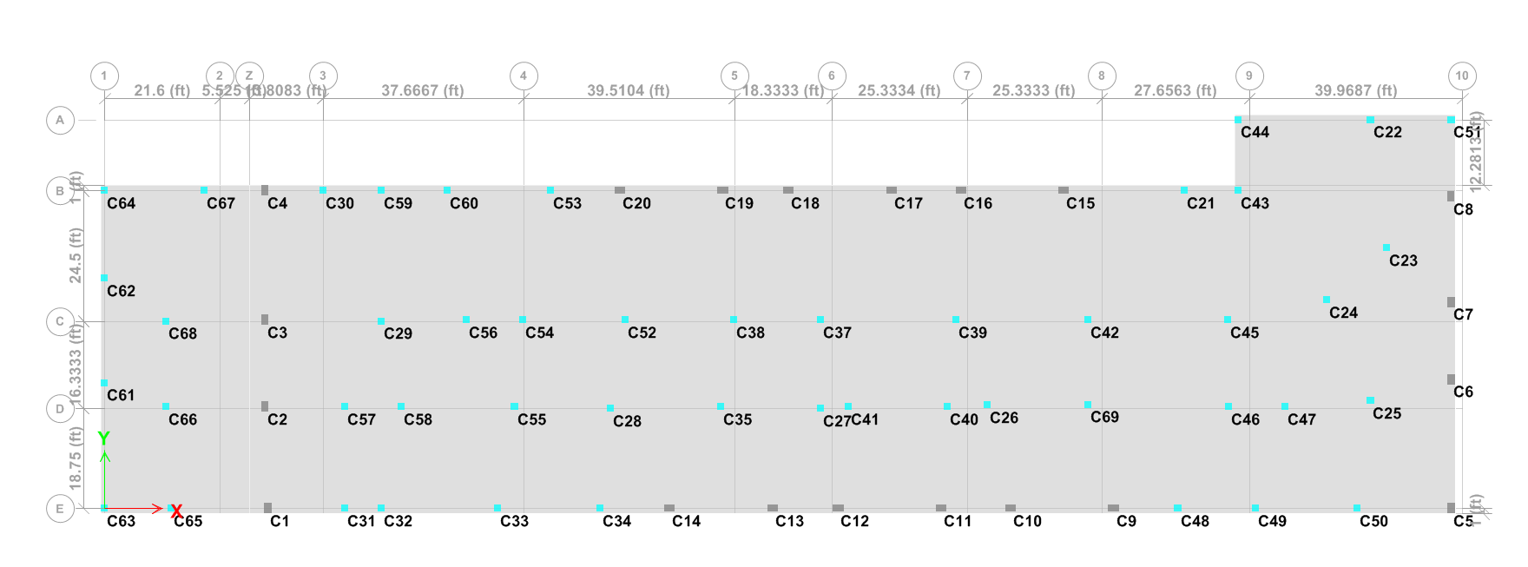
Gravity Column Loads

Slide 35
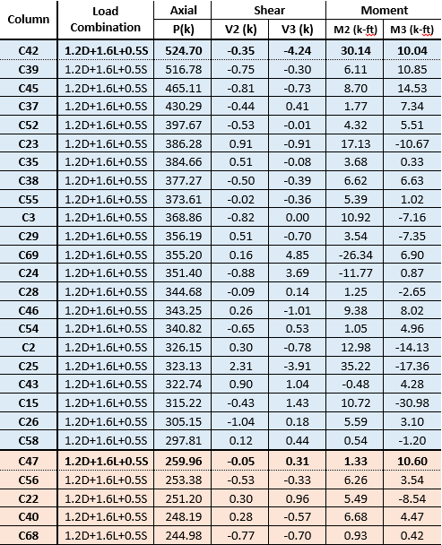
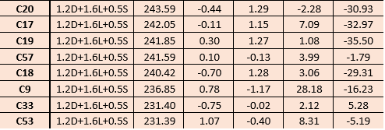
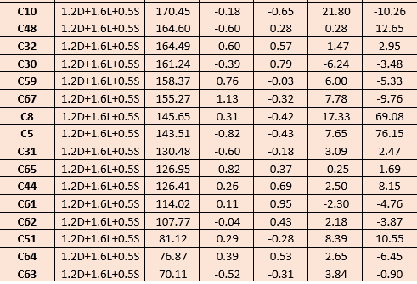
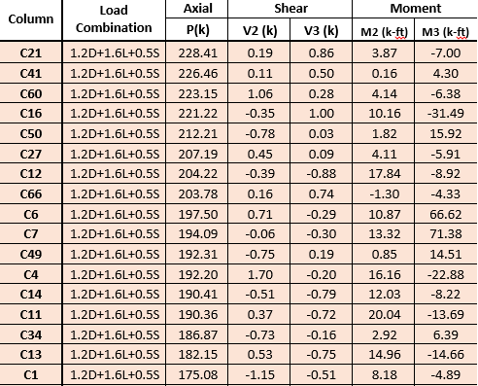
Gravity Column Loads

Slide 36
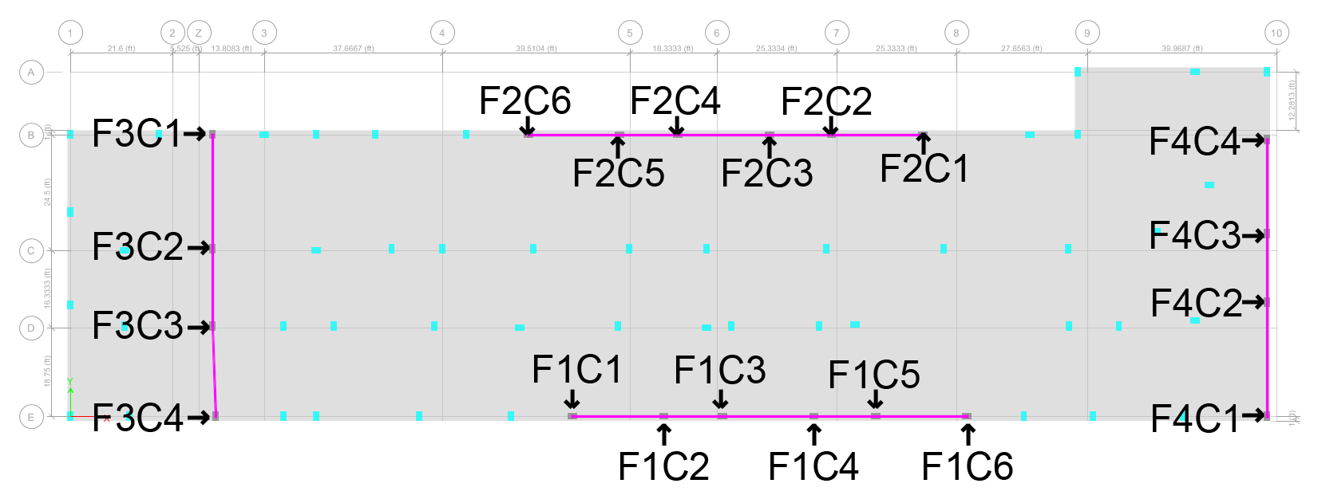
Lateral Column Loads

Slide 37
Lateral Beam Loads

Slide 38
Lateral Beam Loads

Slide 39
2nd Floor

Slide 40
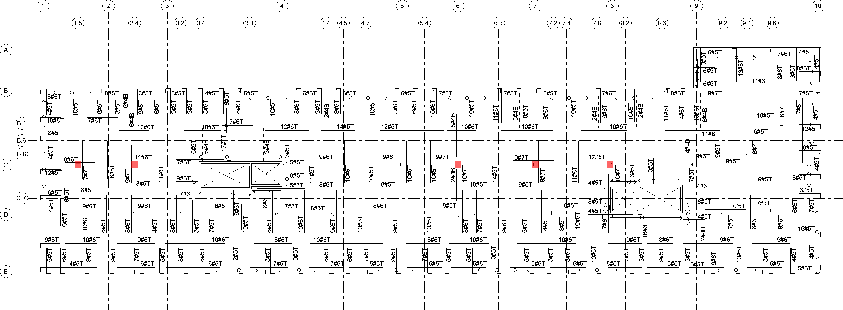
4th Floor

Slide 41
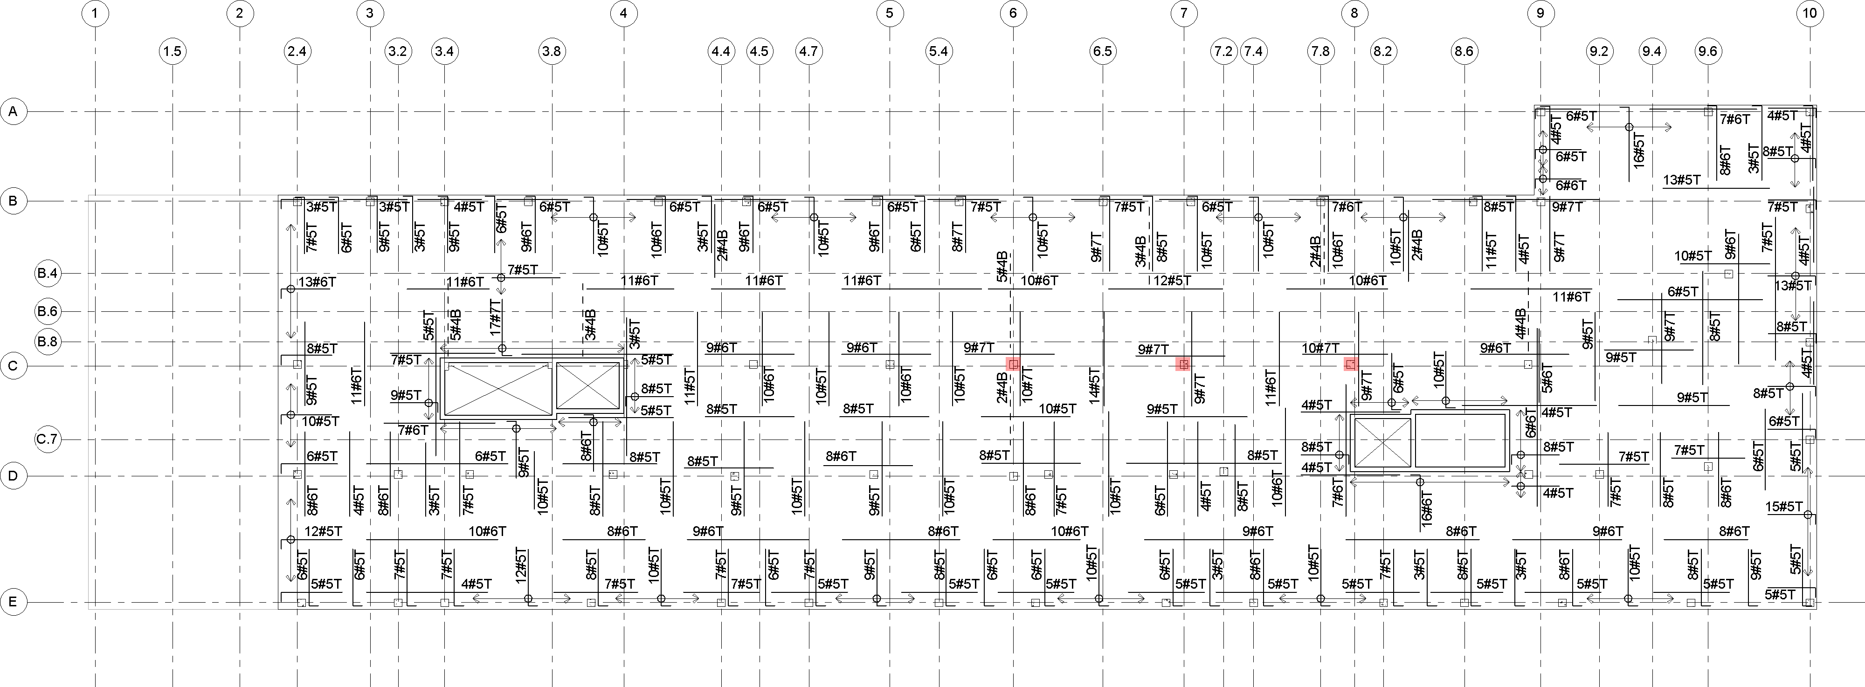
5th Floor

Slide 42
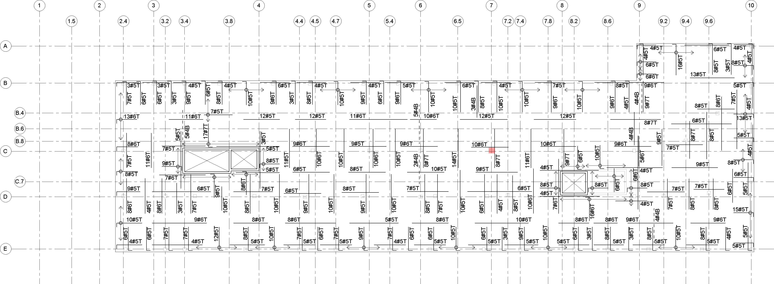
Roof

Slide 43
2nd Floor

Slide 44
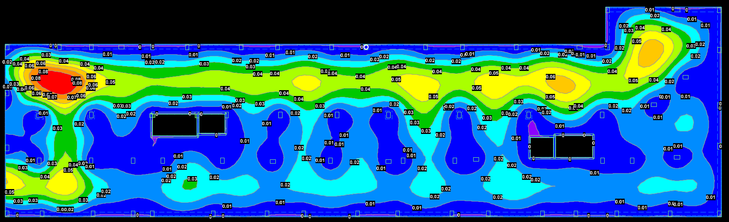

4th Floor

Slide 45
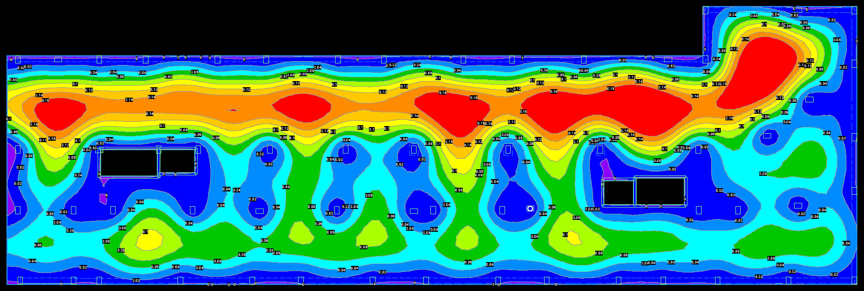

5th Floor

Slide 46
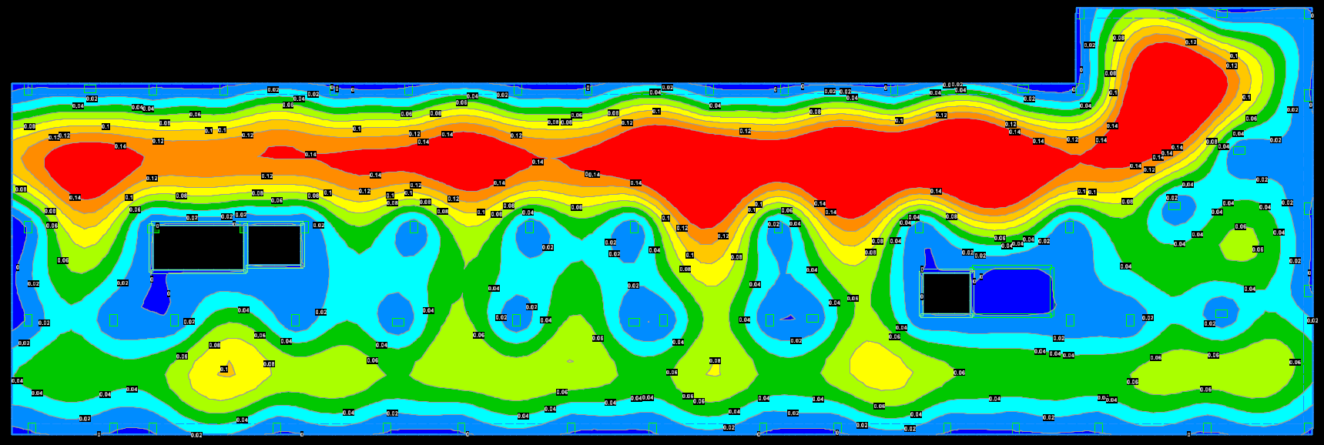

Roof

